Slide 1
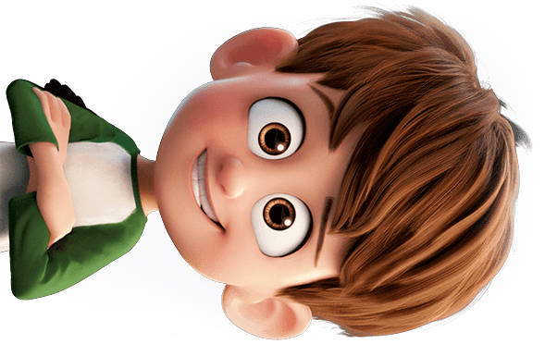
Legend of Lacika™️
Lacika!
We need some milk.

Slide 2
Story
Lacika is chilling at home. His mother asks him to buy some milk from the nearest store. But it’s not that easy to get to the store...

Slide 3
Lacika’s route to the store
Home

Slide 4
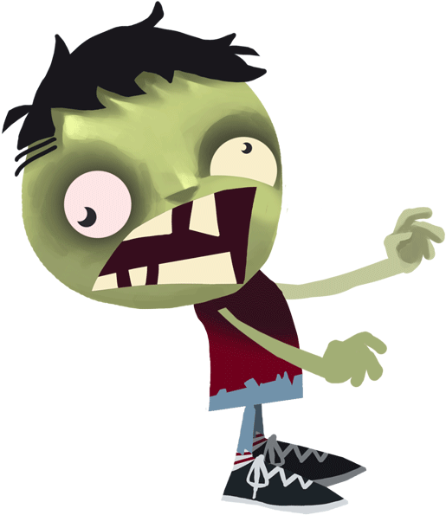
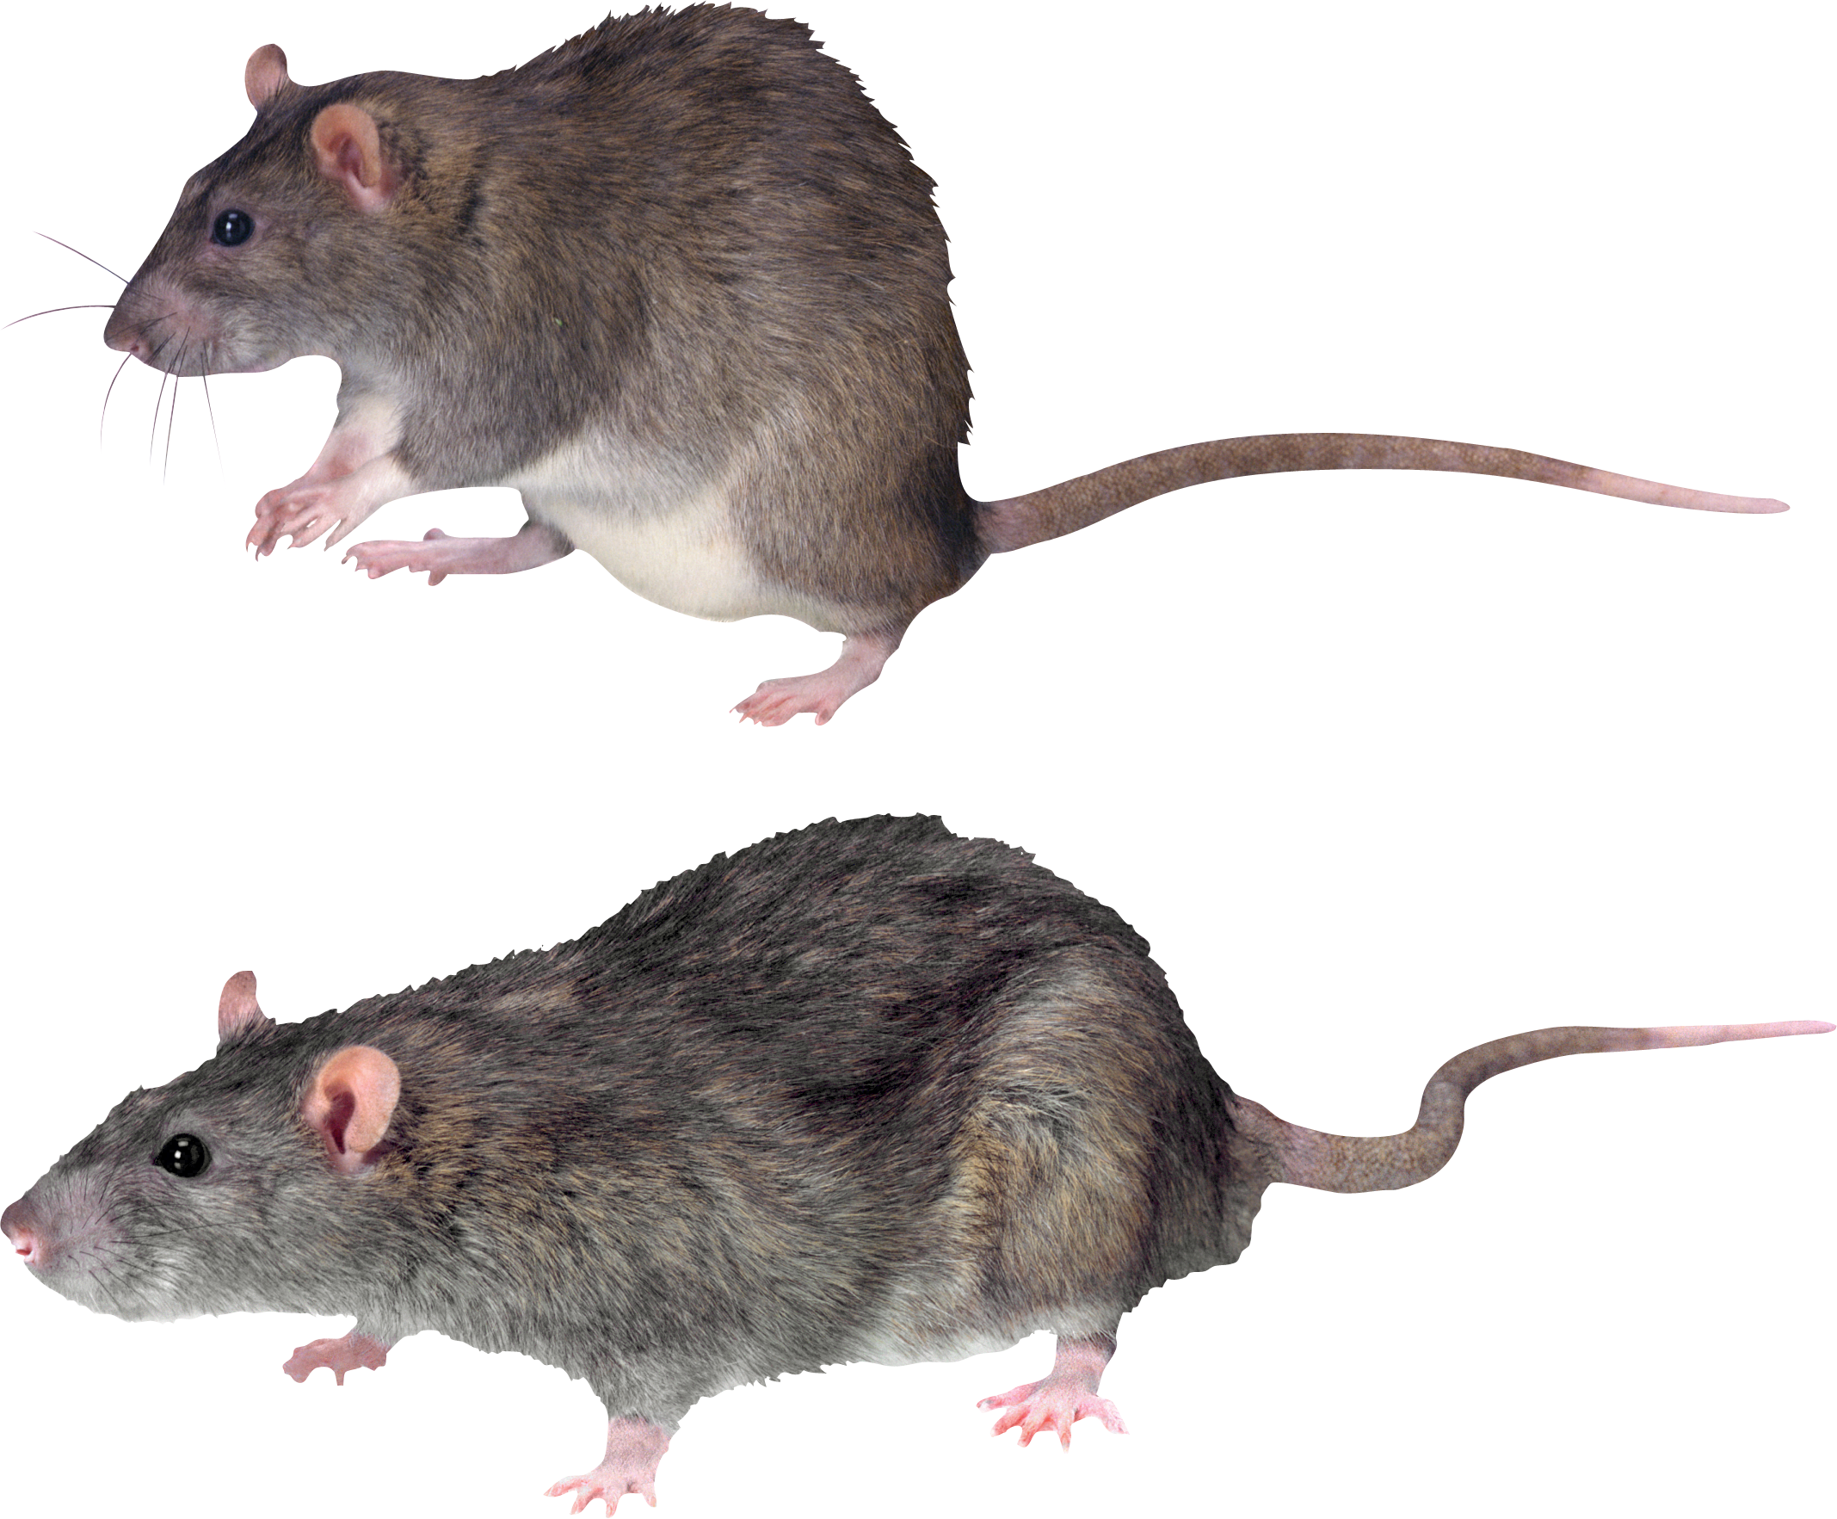
A roguelike game
Levels
Different enemies

